Slide 1
House Price Prediction
By - Ganesh Walimbe

Slide 2
Problem statement
The goal is to understand the relationship between house features and how these variables affect the house price. Using more than one model, predict the price of the house using the given dataset. Please compare the accuracy of the models along with the drawbacks of each technique's assumptions before recommending the final prediction model.

Slide 3
Agenda
Introduction to data
Data preprocessing
Performing exploratory data analysis
Building an prediction model to predict house prices using supervised learning models.
Conclusions

Slide 4
Introduction to data
Data Description :
The data is containing 9 variables with 414 rows and those variables are as follows
Transaction date
House Age
Distance from nearest Metro station (km)
Number of convenience stores
latitude
longitude
Number of bedrooms
House size (sqft)
House price of unit area

Slide 5
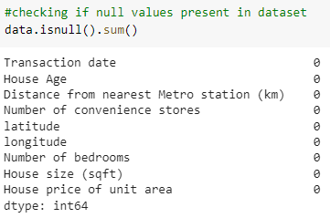

Data preprocessing
There were no missing values present in dataset.
Also there were no duplicates values

Slide 6
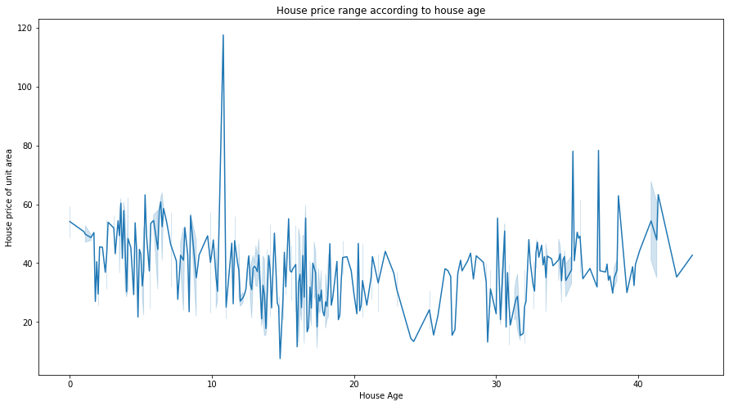
Exploratory data analysis
Exploratory Data Analysis (EDA) is an approach to analyze the data using visual techniques. It is used to discover trends, patterns, or to check assumptions with the help of statistical summary and graphical representations
House price v/s house age
From House price v/s house age lineplot we can see that house price is maximum at 10 year old house

Slide 7
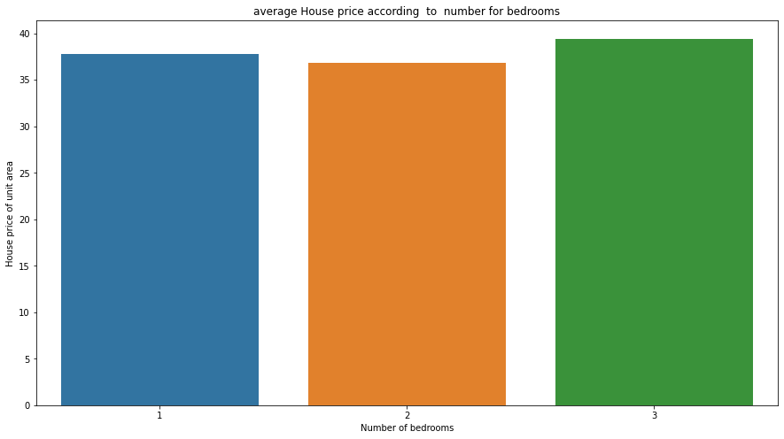
Exploratory data analysis
House price v/s number of bedrooms
From the barplot we can see that
Average price of houses with 1 bedroom is 37.74 per unit area
Average price of houses with 2 bedroom is 36.78 per unit area
Average price of houses with 3 bedroom is 39.43 per unit area

Slide 8
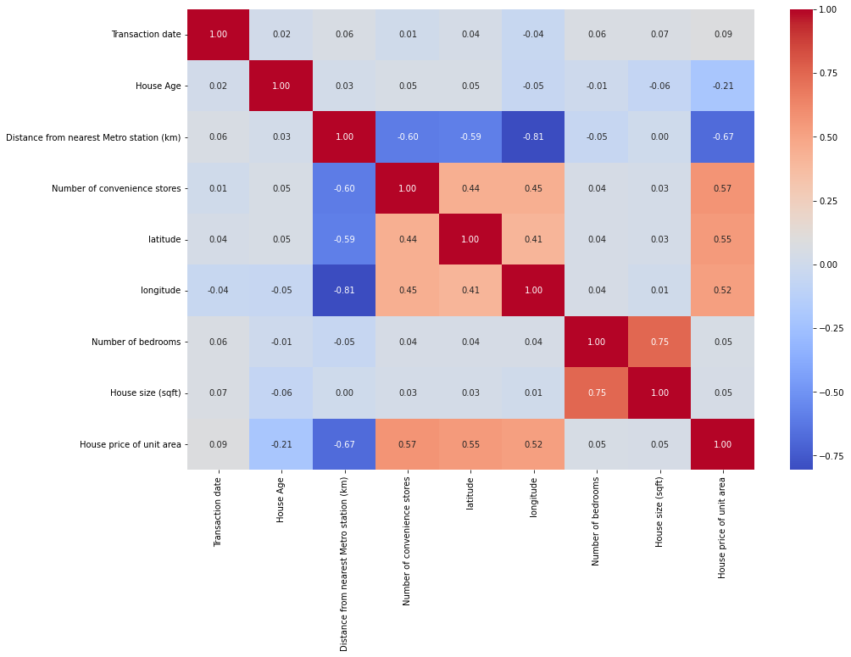
Exploratory data analysis
From correlationplot we can see that
1.There is highly positive correlationship between House price per unit area and Number of convenience stores,latitude ,longitude
2.There is highly negatively correlationship between distance from nearest metro station and House price per unit area

Slide 9
Building prediction models
To build the prediction we first have to perform training and test on the independent and
dependent variables .I am going split data into 80% for training and 20% for testing ,after
that i am going to apply various regression models on training and testing data i will find
out which model is performing best on the dataset
.
The models i am going to use are as follows :
Multiple linear regression
Lasso regression
Random forest regressor

Slide 10
Multiple linear regression
Multiple linear regression (MLR), also known simply as multiple regression, is a
statistical technique that uses several explanatory variables to predict the
outcome of a response variable. The goal of multiple linear regression is to
model the linear relationship between the explanatory (independent) variables
and response (dependent) variables.
Assumptions:
The relation between the dependent and independent variables should be almost linear.
Mean of residuals should be zero or close to 0 as much as possible. It is done to check whether our line is actually the line of “best fit”.
There should be homoscedasticity or equal variance in a regression model. This
assumption means that the variance around the regression line is the same for all values
of the predictor variable (X)
There should not be multicollinearity in regression model. Multicollinearity generally
occurs when there are high correlations between two or more independent variables.

Slide 11
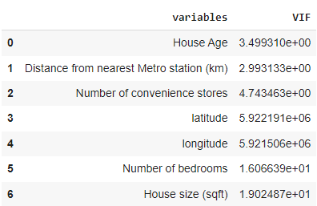
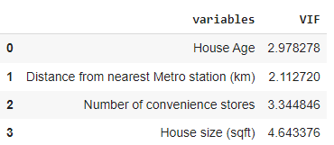
Multiple linear regression
Checking assumptions of MLR
Checking for multicollinearity using VIF
By using VIF we can see that there is high multicollinearity among the variables from
We can remove variables with highest multicollinearity one by one by again checking multicollinearity after each removal to reduce multicollinearity.
After removing highly correlated variables we can from dataframe that multicollinearity has been reduced so we can apply MLR on remaining variables

Slide 12
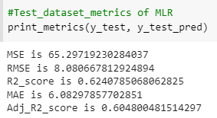
Multiple linear regression
After applying multiple linear regressions on training and testing data i got the r2 score of the model .
The r2_score for the test set is 62% This means our linear regression model is performing well on the data

Slide 13
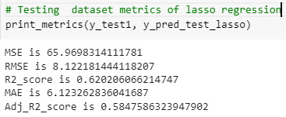
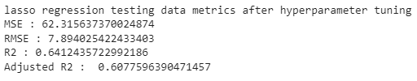
Lasso regression
Lasso regression performs L1 regularization,
which adds a penalty equal to the absolute
value of the magnitude of coefficients. This type
of regularization can result in sparse models with
few coefficients
After applying lasso regressions on training and testing data i got the r2 score of the model
The r2 score for lasso regression for testing
data is 62%.
The r2 score for lasso regression after hyperparameter tuning for testing
data is 64%.

Slide 14
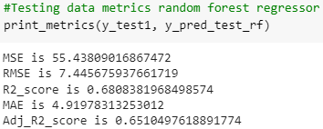
Random forest regressor
Random forests or random decision
forests is an ensemble learning method for
classification,regression and other tasks that
operates by constructing a multitude
of decision trees at training time.
After applying random forest model on training and testing data i got the r2 score of the model .
The r2 score for random forest model for training data is 68%.

Slide 15
Conclusions
Conclusions from EDA :
From lineplot we conclude that house price is maximum at 10 year old house
Average price of houses with 1 bedroom is 37.74 per unit area
Average price of houses with 2 bedroom is 36.78 per unit area
Average price of houses with 3 bedroom is 39.43 per unit area
From correlationplot we found out that
There is highly positive correlationship between House price per unit area and Number of convenience stores,latitude ,longitude.
There is highly negatively correlationship between distance from nearest metro station and House price per unit area because as the distance from the metro station increases the price of house decreases

Slide 16
Conclusion
Conclusions from Regression models :
The multiple linear regression is giving us R2 score of 62% for testing dataset but all the assumptions of Multiple linear regression are not satisfied.
Lasso regression is giving us R2 score of 62% and after hyperparameter tuning the R2 score has increased to 64% for testing dataset
Random forest regressor has given highest R2 score among all the model i.e. 68% for testing data and the important factors according to random forest model are Distance from nearest metro station ,House age,latitude,longitude and house size(sqft)
As the R2 score of random forest is highest among all the models so we can use random forest to predict the house prices.

Slide 17
Thank you

